Slide 1
Neural POS Tagger
NLP Project:
TEAM Name: Lemmatizer
Tirth Pandit (2019201017)
Pratik Tiwari (2019201023)
Mentor: Ujwal Narayan
Github Repo: https://github.com/pratikiiith/Neural-POS-Tagger-NLP.git

Slide 2
Problem Statement
POS tagging is the process of tagging the words with their categories that best suits the definition of the word as well as the context of the sentence. It is often the first step for many NLP applications.
Aim of the project is to create the Neural network based POS Tagger for Gujrati Language.
In general and Gujrati Language in particular is not a very widely explored language in NLP Tasks. Also morphological complexity of the language makes it hard to develop NLP applications around it.
Previous Work has been done in the area of POS Tagging in Gujrati Language which uses different approaches like HMM (Hidden Markov Models) and CRF( Conditional Random Fields)
Purpose of this Project also includes the comparisons between these classical approaches and Neural POS Tagger

Slide 3
Dataset
Gujarati Monolingual Text Corpus ILCI-II
30,000 sentences of general domain.
The translated sentences have been POS tagged according to BIS (Bureau of Indian Standards) tag set.
https://www.ldcil.org/Download/Tagset/LDCIL/5Gujrati.pdf
It has eleven primary tags and similarly it divides in sub tags. Main classes of Tag-set are:
Demonstrative (DM) , Post Position (PSP) , Noun (NN)
Adverb (RB) , Verb (V) , Pronoun (PR)
Conjunction (CC) , Particles (RP) , Quantifier (QT)
Adjective (JJ) , Residual(RD).

Slide 4
Baseline Model
In this phase our aim is to implement and test the HMM and CRF Model for pos tagging the Given Dataset . Following research papers are used as the reference.
Part-Of-Speech Tagging for Gujarati Using Conditional Random Fields ( Chirag Patel and Karthik Gali )
This paper describes a CRF machine learning algorithm for Gujarati Part of Speech Tagging.
This CRF model when provided with good features gives accuracy much better than other models.
The intuition presented in this paper is to convert the linguistic rules specific to Gujarati in to features which then provided to CRF. This method make use of advantages of both statistical and rule based approach.

Slide 5
Baseline Model
2. Hindi POS Tagger Using Naive Stemming : Harnessing Morphological Information Without Extensive Linguistic Knowledge ( Manish Shrivastava ,Pushpak Bhattacharyya )
This paper presents a simple HMM based POS tagger, which employs a naive(longest suffix matching) stemmer as a pre-processor which helps to achieve reasonably good accuracy of 93.12%.
This method does not require any linguistic resource apart from a list of possible suffixes for the language.
Core idea of the method is to use Exploding Input which increase the length of the input and reduces the number of unique types encountered during learning which in turn increases the probability of the correct choices.
Other idea this paper presents is that for a consistent stemming scheme can be developed by providing a simple list of all possible suffixes in the language which can be used for splitting resulting. Tagging root words and suffix alone is easy task comparatively. Then HMM is used on top of this preprocessing tasks for POS Tagging.

Slide 6
A Statistical Method for Evaluating Performance of Part of Speech Tagger for Gujarati ( Pooja M. Bhatt, Amit Ganatra )
This article presents POS tagging for Gujarati textual content the use of Hidden Markov Model. Using Gujarati text annotated corpus for training checking out statistics set are randomly separated. 80% accuracy is given by model. It discusses 2 approaches for POS tagging.
One is Supervised POS Tagging which requires tagged dataset this is used for studying details about rule sets, word-tag frequencies, tag gadgets, and so forth. The overall performance of supervised pos tagger fashions boom with enhancement of corpus’s length.
Second is Unsupervised POS Tagging The Model does now not require tagged dataset. By applying computational techniques together with the transformation rules, Algorithm to generate tag clusters.
4. POS Tagging For Resource Poor Indian Languages Through Feature Projection ( Pruthwik Mishra, Vandan Mujadia, Dipti Misra Sharma)
This Paper describes POS tagging without any labeled data. Our method requires translated sentences from a pair of languages. We used feature transfer from a resource rich language to resource poor languages. Core idea discussed in this paper is the feature representation transfer.
Method described here consists transferring the knowledge acquired from a language to another language. This approach does mapping between the feature sets of the concerned languages and resource poor language.
For Feature mapping it uses word alignment methods between source and resource poor languages. Features are generated using prefix and suffix of the word which is to be used for POS Tagging. Conditional random fields are then used for POS tagging for the resource poor language.

Slide 7
Neural based Model
In this phase our aim is to Implement Neural Network Based POS Tagger , and compare results of Previous models and Neural based Model.
Following Research Papers are used for the Reference
A Neural Network Model for Part-Of-Speech Tagging of Social Media Texts This paper presents a neural network model for Part-Of-Speech (POS) tagging of User-Generated Content (UGC) such as Twitter, Facebook and Web forums. The proposed model uses both character and word level representations. Character level representations are learned during the training of the model through a Convolutional Neural Network (CNN). For word level representations paper describes combine several pre-trained embeddings (Word2Vec, FastText and GloVe ). To tackle the issue of the poor availability of annotated data on social media paper uses transfer learning . Neural model that we use for Transfer Learning experiments is based on bidirectional hierarchical Gated Recurrent Units (GRUs). In this case, the source domain is the some well established language and the target domain is the social media text of the same language. It also uses 2 types of feature representations : character level and word level. CNN architecture is used for character level feature generation and Pretrained word embeddings are used for word level representation.
Part-Of-Speech Tagging using Neural network by Ankur Parikh This paper presents two novel approaches of POS tagging using Neural network for Hindi language and compares them with two other machine learning approaches, HMM and CRF. In this paper, a single-neuro tagger, a Neural network based POS tagger with fixed length of context chosen is presented . Then, a multineuro tagger which consists of multiple single-neuro taggers with fixed but different lengths of contexts is presented. Multineural tagger performs tagging by voting on the output of all single-neuro taggers.

Slide 8
Neural based Model
Neural Network based Parts of Speech Tagger for Hindi
In this paper, Artificial Neural Network for Hindi parts of speech tagger has been used. Uses Rule base POS Tagger as the initial classifier and on top of it trains the Neural network to finally classify the words in tag classes.
The Rule based POS tagger tag the POS by simply using the Lexicon. The outcome of the Rule based POS Tagger is not perfect, for correction and accuracy it finally passes through the ANN based POS tagger. Here the ANN is used for pattern Recognition of corpus to identify and correct the POS tagging
GENERAL REGRESSION NEURAL NETWORK BASED POS TAGGING FOR NEPALI TEXT
This article presents Part of Speech tagging for Nepali text using General Regression Neural Network (GRNN). The corpus is divided into two parts viz. training and testing. The network is trained and validated on both training and testing data.
It is observed that 96.13% words are correctly being tagged on training set whereas 74.38% words are tagged correctly on testing data set using GRNN. It compares GRNN based POS Tagger with Viterbi Algorithm with conclusion that GRNN POS tagger is more consistent than the traditional Viterbi decoding technique. Transition and Emission probability matrices are constructed from the training data and this both matrices are used to calculate the feature of the each word which is then used as input to GRNN.

Slide 9
Architecture
Neural Architectures we are considering
LSTM or GRU based Architectures with training of Word embeddings ( May use pretrained Gujarati word embeddings or Train word embedding if enough data is there )
General Regression neural Networks
Artificial Neural Network on top of Rule based POS tagger
Model Evaluation
Model Evaluation will be done with Their Accuracy scores and F1 scores. Also will perform Error analysis on each of the models.

Slide 10
Project Timeline
Mid-Evaluation / Interim Report
Final Report
Deciding Neural Arch. and experimental setup
Testing/Tuning and bug Fixing
25th March 2021
20th April 2021
Implementation HMM and CRF
Implementation of Neural POS Tagger

Slide 11
Final Deliverables
1. HMM and CRF implementation + result metrics on given dataset
2. Classical approaches + Neural POS tagger implementation ( LSTM or GRU or Transformers )
3. Comparison Metrics for baseline and Neural based model.
4. Project Report
5. Saved checkpoint
6. Final presentation + Readme file

Slide 12
Neural POS Tagger Midterm report
NLP Project:
TEAM Name: Lemmatizer
Tirth Pandit (2019201017)
Pratik Tiwari (2019201023)
Mentor: Ujwal Narayan
Github Repo: https://github.com/pratikiiith/Neural-POS-Tagger-NLP.git

Slide 13
Project Mid-Evaluation
Mid-Evaluation / Interim Report
Final Report
Deciding Neural Arch. and experimental setup
Testing/Tuning and bug Fixing
25th March 2021
20th April 2021
Implementation HMM and CRF
Implementation of Neural POS Tagger
Completed

Slide 14
Data Set Details:
guj_art and culture_sample1.txt
guj_economy_sample2.txt
guj_entertainment_sample3.txt
guj_philosophy_sample4.txt
guj_religion_sample5.txt
guj_science and technology_sample6.txt
guj_sports_sample7.txt

Slide 15
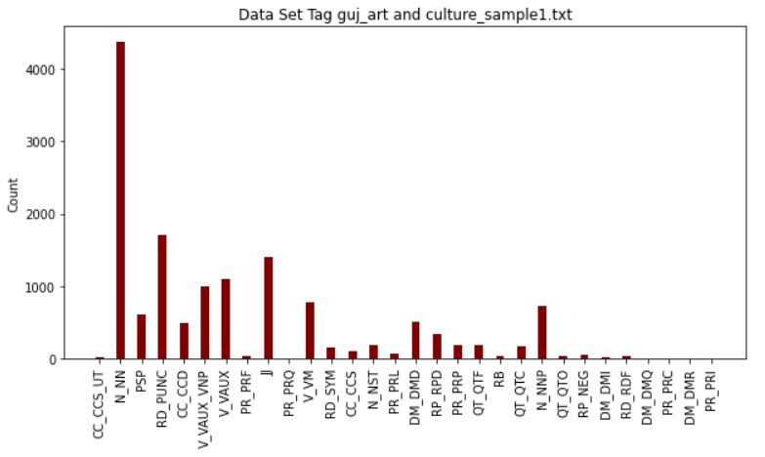
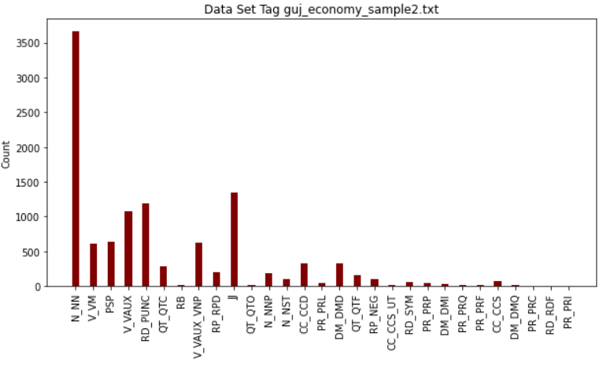
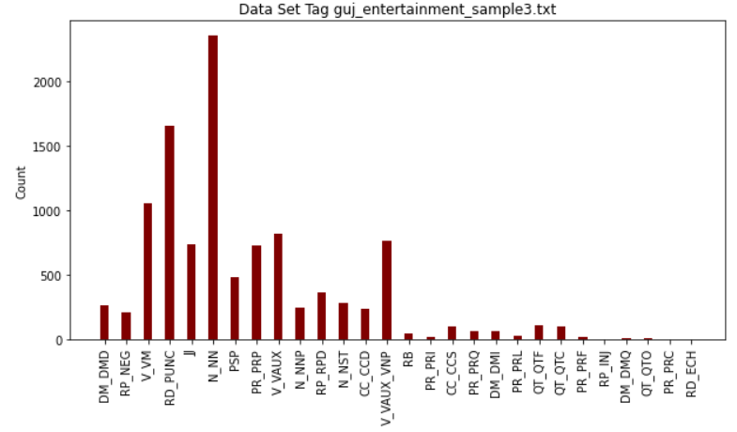
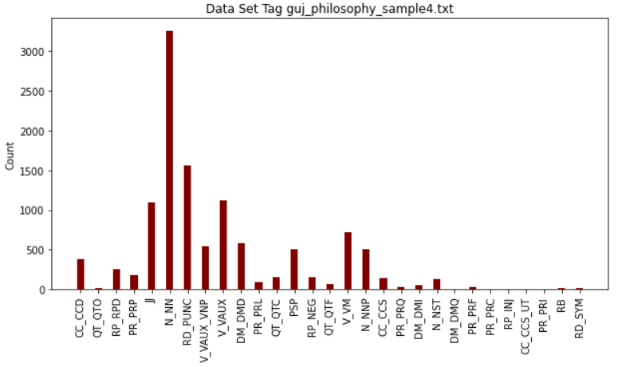

Slide 16
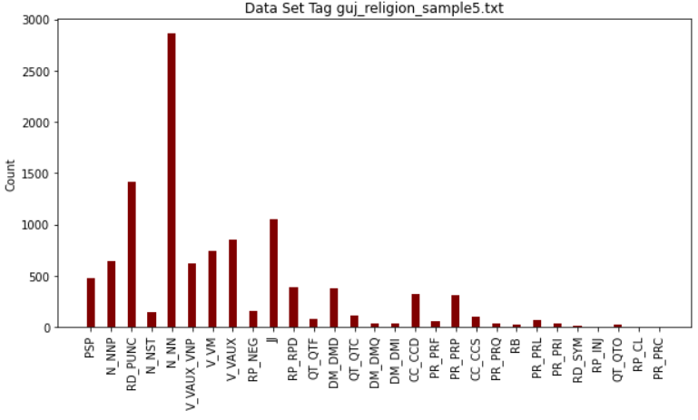
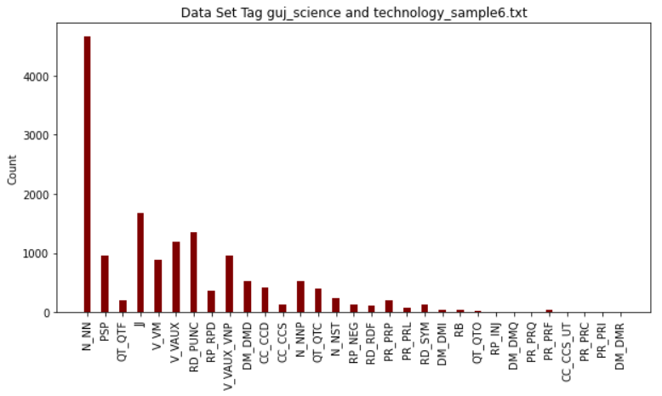
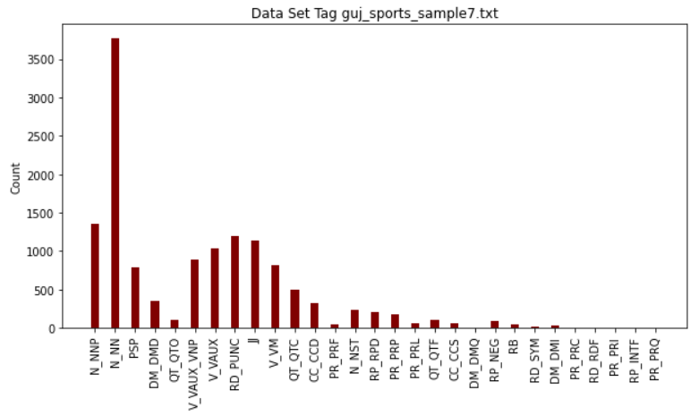

Slide 17
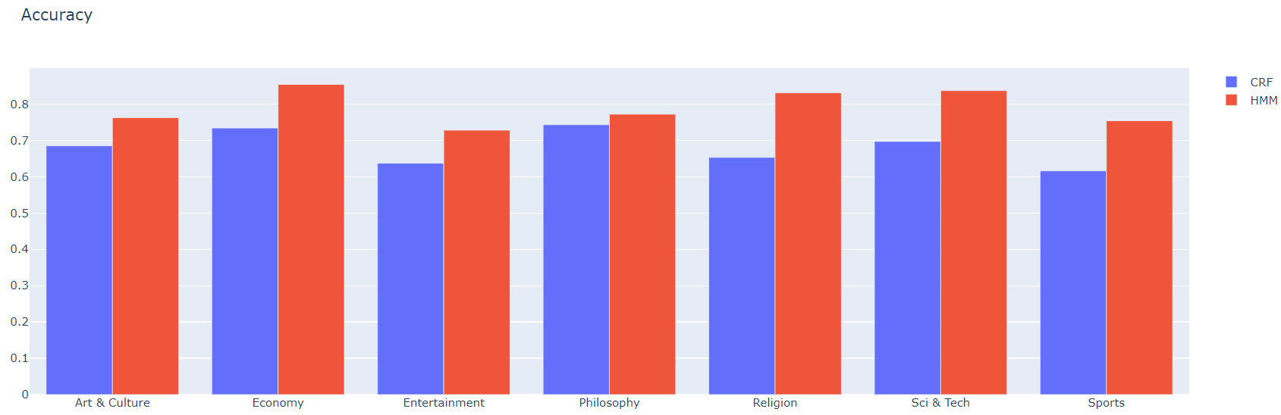
Accuracy: HMM vs CRF

Slide 18
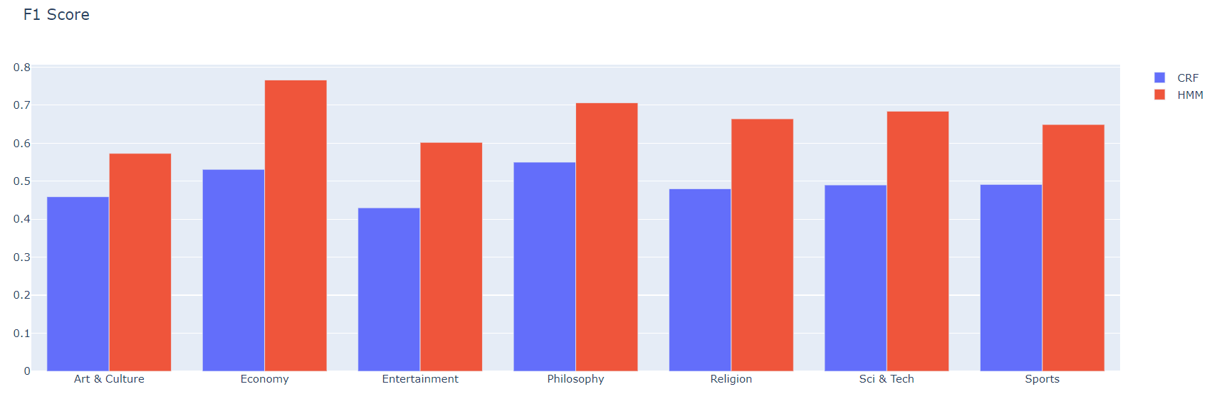
F1-Score : HMM vs CRF

Slide 19
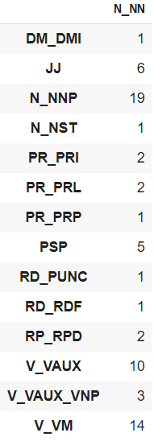
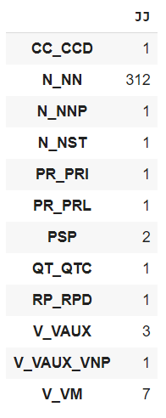
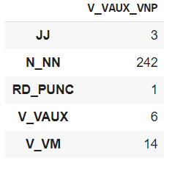
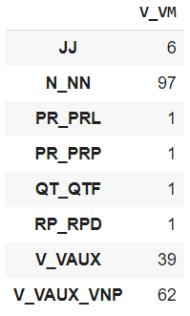
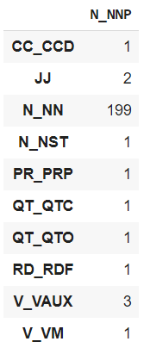
Error Analysis HMM

Slide 20
Row -> Actual Column -> Predicted

Slide 21
Error Analysis CRF

Slide 22
Neural Model
We will try to implement 3 neural network based Approaches
LSTM based neural network with One hot encoded Features of the word
Each word will be one hot encoded with the training data vocabulary. Then LSTM based neural network will be trained with this one hot vectors and their tags
Word embedding + Neural networks
Train the word embedding based model first using skip gram or Cbow.
Which then used to train the LSTM based neural network.
Try to do end to end training with both word embedding and Neural network simultaneously.
General Regressing neural network
GRNN based POS Tagger with Viterbi Algorithm uses transition and Emission probability matrices which are constructed from the training data and this both matrices are used to calculate the feature of the each word which is then used as input to GRNN. Which then used to predict the class of the word.

Slide 23
Implementation

Slide 25
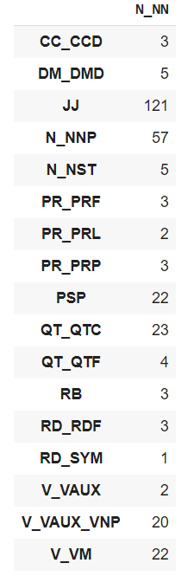
Error Analysis

Slide 26
Row -> Actual Column -> Predicted

Slide 27
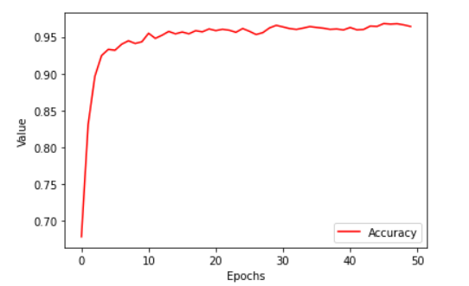
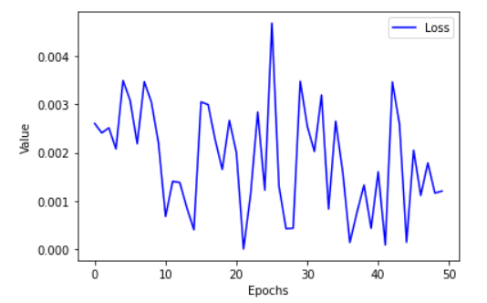
Accuracy and Loss single dataset

Slide 28
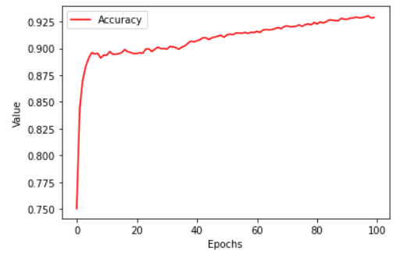
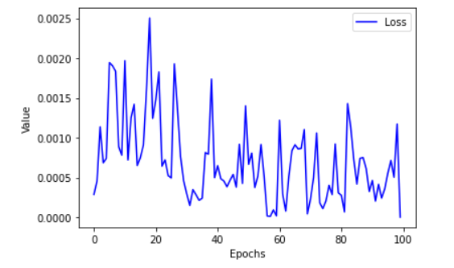
Accuracy and Loss Complete datset

